Slide 1
Inversions

Slide 2
Outline
Given an unsorted list, one measure of unsortedness is the number of inversions
Review of inversions
Distribution of inversions for randomly generated lists
Counting inversions:
Straight-forward algorithm is has a Θ(n²) run time
Using ideas from merge sort, we can reduce this to a Θ(n ln(n)) run time

Slide 3
Inversions
8.9
Given an unsorted list
(a₁, a₂, a₃, …, a_{n}),
an inversion is any pair (a_{i}, a_{j}) where i < j but a_{i} > a_{j}
For example, the unsorted list
6, 12, 9, 18, 19, 4, 3
contains 9 inversions:
(6, 4), (6, 3), (12, 9), (12, 4), (12, 3), (18, 4), (18, 3), (19, 4), (19, 3)

Slide 4
Basic properties
8.9.1
Recall that the expected number of inversions is
and in the previous list, we would have expected
if the list was randomly generated
Recall that swapping two adjacent entries in the unsorted list will either add or remove exactly one inversion

Slide 5
Variation
8.9.2
If the number of inversions is, on average, O(n²), one may ask:
Is it possible, never-the-less, to randomly generate a list which has only a few inversions?
We will investigate the standard deviation for the number of inversions
The standard deviation is the square root of the variance

Slide 6
Variation
8.9.2
The variance of the number of inversions is given by
Consequently, the standard deviation of the average number of inversions only grows by Θ(n^{3/2}) = o(n²)
you are essentially guaranteed that a random list will have Θ(n²) inversions

Slide 7
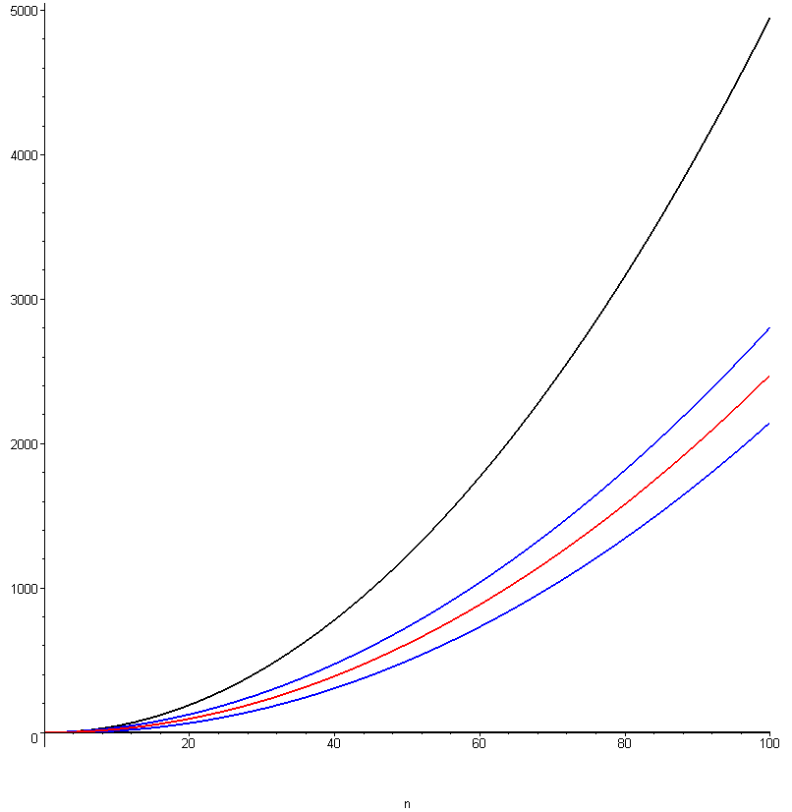
Variation
8.9.2
This plots the average number of inversions together with a 95% confidence interval for n ≤ 100
—— maximum number of inversions
—— average number of inversions
—— 95% confidence interval

Slide 8
Variation
8.9.2
What is a 95% confidence interval?
For every 100 randomly generated lists, 95 of those will fall within the given range
You will recall polls which are correct 19 times out of 20 – this is a 95% confidence interval
For example, 19 out of 20 randomly-generated lists of size n = 56 will fall within the interval of
inversions

Slide 9
Counting Inversions
8.9.3
Suppose we want to count the number of inversions
We could simply consider all ordered pairs and check whether or not the pair is inverted
This would require
comparisons and thus we would have an Ω(n²) run time

Slide 10
Counting Inversions
8.9.3.1
This algorithm does exactly that: compare all pairs and test whether or not they are out of order
template <typename Type> int inversions( Type *array, int n ) const {
int count = 0;
for ( int i = 0; i < (n - 1); ++i ) {
for ( int j = (i + 1); j < n; ++j ) {
if ( array[i] > array[j] ) {
++count;
}
}
}
return count;
}

Slide 11
Counting Inversions
8.9.3.1
The run time, however, is clearly Θ(n²)
template <typename Type> int inversions( Type *array, int n ) const {
int count = 0;
for ( int i = 0; i < (n - 1); ++i ) {
for ( int j = (i + 1); j < n; ++j ) {
if ( array[i] > array[j] ) {
++count;
}
}
}
return count;
}

Slide 12
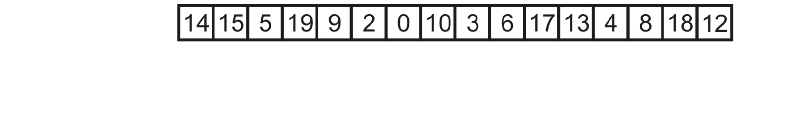
The Algorithm
8.9.3.2
Can we reduce this to something faster?
Let’s go back to merge sort
The following unsorted list has 58 inversions
With n = 16, we expect, on average inversions
Reference: Kleinberg and Tardos

Slide 13
The Algorithm
8.9.3.2
Start with an unsorted list and go through the motions of merge sort

Slide 14
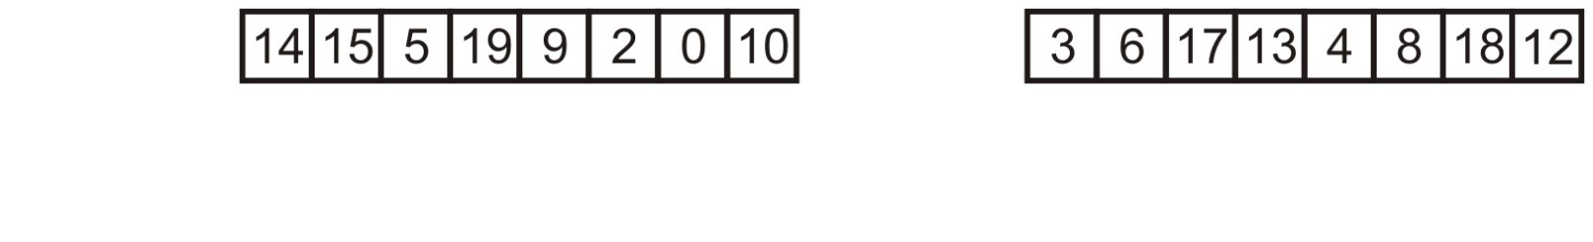
The Algorithm
8.9.3.2
Split the list into two and assume we have recursively found the number of inversions in both the left and right halves

Slide 15
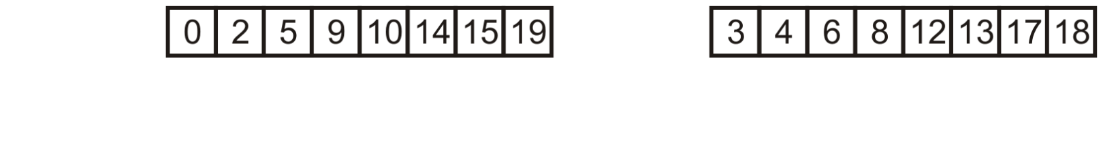
The Algorithm
8.9.3.2
For example, suppose in the process of sorting these two halves, we also determined the number of inversions in each:
In this case, 19 in the left half and 9 in the right half

Slide 16
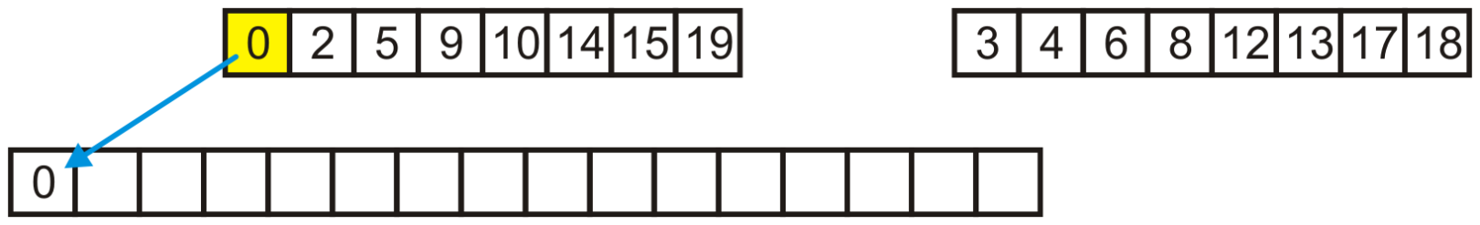
The Algorithm
8.9.3.2
In merging them, we begin by copying 0 to the full array

Slide 17
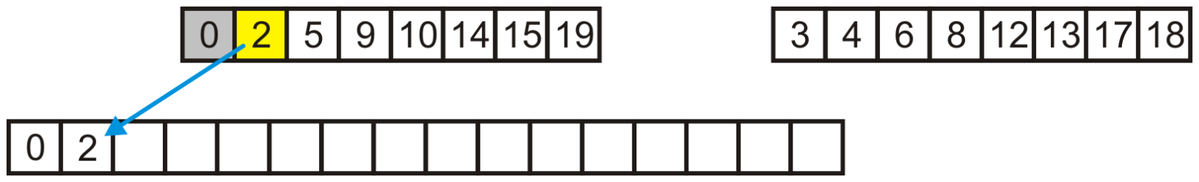
The Algorithm
8.9.3.2
Next, we copy two, also from the left half

Slide 18
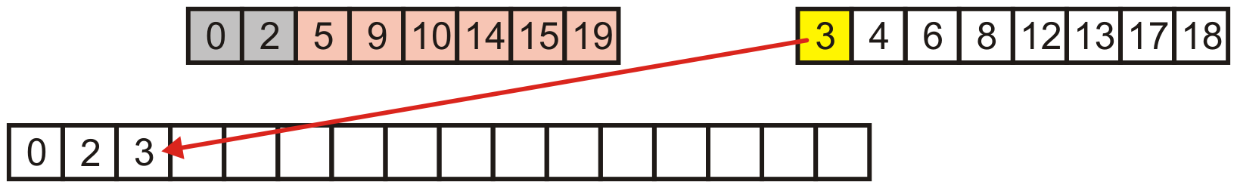
The Algorithm
8.9.3.2
However, when we copy 3, notice that 3 was moved in front of
5, 9, 10, 14, 15 and 19
In the original list, this formed six inversions

Slide 19
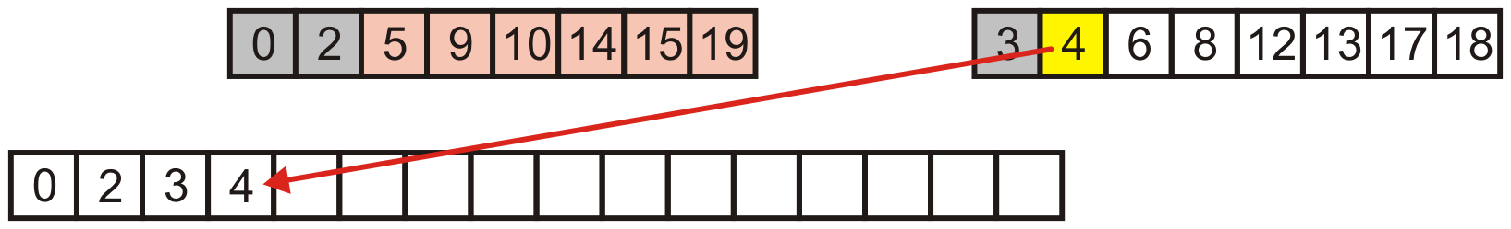
The Algorithm
8.9.3.2
Similarly, in merging 4, it is moved in front of another 6 entries

Slide 20
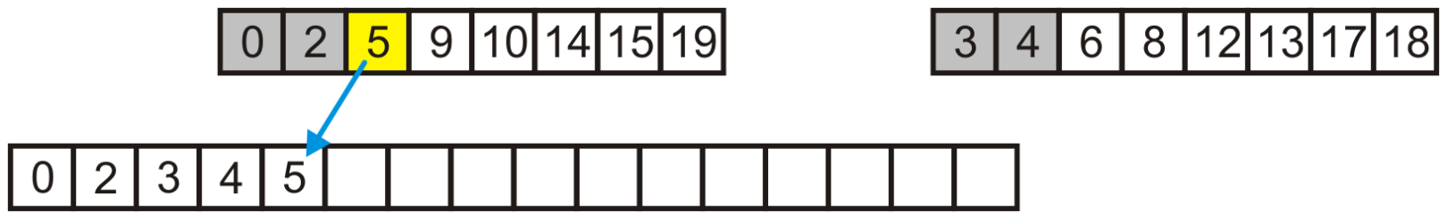
The Algorithm
8.9.3.2
Next, 5 is copied from the first array

Slide 21
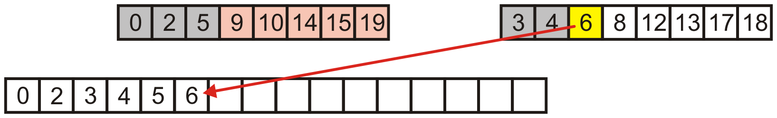
The Algorithm
8.9.3.2
But then 6 is copied from the second, now removing 5 inversions

Slide 22
The Algorithm
8.9.3.2
This would give us
6 + 6 + 5 + 5 + 3 + 3 + 1 + 1 = 30
inversions
Together with the 19 and 9 inversions, we have the expected total number of inversions: 58
We could find 19 and 9 recursively
A list of size 1 has no inversions
Reference: Kleinberg and Tardos

Slide 23
The Algorithm
8.9.3.2
Ultimately, this would count all the inversions in the unsorted list and, simultaneously, sort the list
Cost? Θ(n) memory
The implementation is as straight-forward as merge sort

Slide 24
Implementation
8.9.3.3
template <typename Type>
int inversions( Type *array, int n ) {
if ( n <= 1 ) {
return 0;
}
nl = n/2;
nr = n - n/2;
Type larray[nl];
Type rarray[nr];
// split the array into two halves
split( array, n, larray, nl, rarray, nr );
// recursively call inversions on both halves
int count = inversions( larray, nl ) + inversions( rarray, nr );
// merge returns the number of inversions as a result of merging
return count + merge( array, n, larray, nl, rarray, nr );
}

Slide 25
Implementation
8.9.3.3
The helper function split divides the entries of array between the two arrays larray and rarray
template <typename Type>
void split( Type *array, int n, Type *larray, int nl,
Type *rarray, int nr ) {
assert( nl + nr == n );
for ( int i = 0; i < nl; ++i ) {
larray[i] = array[i];
}
for ( int i = 0; i < nr; ++i ) {
rarray[i] = array[nl + i];
}
}

Slide 26
Implementation
8.9.3.3
This function merges the two sorted lists and returns the inversions
template <typename Type>
int merge( Type *array, int n, Type *larray, int nl, Type *rarray, int nr ) {
int il = 0, ir = 0, ia = 0, count = 0;
while ( il < nl && ir < nr ) {
if ( larray[il] <= rarray[ir] ) {
array[i] = larray[il];
++il;
} else {
array[i] = rarray[ir];
++ir;
count += nl - il; // we moved the entry in right array past anything
} // not yet merged from the left array
++i;
}
for ( ; il < nl; ++il, ++i ) array[i] = larray[il];
for ( ; ir < nr; ++ir, ++i ) array[i] = rarray[ir];
return count;
}

Slide 27
Summary
This topic covered counting inversions:
The classic algorithm has a Θ(n²) run time
Using merge sort, Θ(n ln(n)) run
The cost is Θ(n) memory

Slide 28
References
[1] Jon Kleinberg and Éva Tardos, Algorithm Design, Addison Wesley, 2006, §5.3, pp.221-225.

Slide 29
References
Wikipedia, http://en.wikipedia.org/wiki/Inversion_(discrete_mathematics)
[1] Jon Kleinberg and Éva Tardos, Algorithm Design, Addison Wesley, 2006, §5.3, pp.221-225.
These slides are provided for the ECE 250 Algorithms and Data Structures course. The material in it reflects Douglas W. Harder’s best judgment in light of the information available to him at the time of preparation. Any reliance on these course slides by any party for any other purpose are the responsibility of such parties. Douglas W. Harder accepts no responsibility for damages, if any, suffered by any party as a result of decisions made or actions based on these course slides for any other purpose than that for which it was intended.

